Slide 1
Strategic Action Plan 2024-2029
What’s important to you?

Slide 2
Methodology
Online survey opened 23 April and closed 31 August 2024
During this period, a number of press releases were made plus the survey was extensively advertised on social media
502 responses received
A number of in person sessions were also held although these were poorly attended
Respondents were asked to rank each of the Key Objectives under the Six Strategic Objectives as follows: 5 = Very Important; 4 = Important; 3 = Neutral; 2 = Unimportant; 1 = Very Unimportant
Respondents were also asked for any comments they had about each group of Key Objectives

Slide 3

Building Resilient Communities for Shrewsbury
We will acknowledge and build upon our town’s diversity, demonstrating our leadership role by working with
and empowering our partners and local people to provide healthy, safe and cohesive communities.
Our Key Objectives
To Develop and Enhance the Town Council’s Youth Offer
To Support community resilience to ensure sustainability
To Provide appropriate Grant Funding
To Enhance Partnership Working to support the community
To Ensure that the Town Council promotes Equality, Diversity and Inclusion through its values and provision of services
Strategic Ambition One

Slide 4
Q1: To develop a Youth Council and Young Mayor position
Answered: 488 Skipped: 14

Slide 5
Q2: To develop apprenticeship opportunities
Answered: 495 Skipped: 7

Slide 6
Q3: To enhance the Town Council’s youth club provision
Answered: 490 Skipped: 12

Slide 7
Q4: To develop community centres across the town
Answered: 491 Skipped: 11

Slide 8
Q5: To promote Town Council grant funding opportunities
Answered: 490 Skipped: 12

Slide 9
Q6: To work with local communities to create a lasting memorial to HM Queen Elizabeth II
Answered: 485 Skipped: 17

Slide 10
Q7: To work in partnership to support a town-wide Neurodiversity Strategy
Answered: 488 Skipped: 14

Slide 11
Q8: To support activities which assist the Violence against Women and Girls initiative
Answered: 489 Skipped: 13

Slide 12
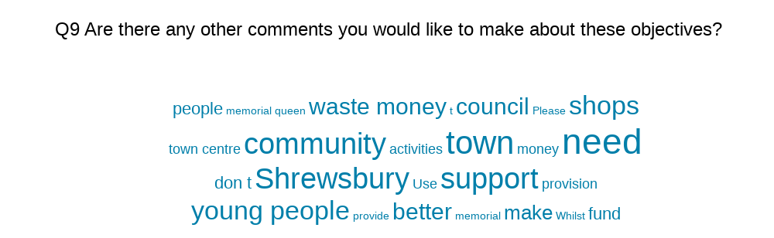

Slide 13

Strategic Ambition Two
Supporting Shrewsbury residents to live active and healthy lives through the provision of quality services
We will, through the provision of quality services, provide opportunities for local people to live active and healthy lives in a safe environment.
Our Key Objectives:
To Develop and Promote Play Facilities
To Develop and promote Sports Facilities & Open Spaces
To Encourage Healthy Lifestyles
To Work in Partnership to promote a Safer Town

Slide 14
Q10: To create a Play Area Refurbishment Plan based upon depreciation and usage to include inclusive play
Answered: 476 Skipped: 26

Slide 15
Q11: To create a plan to set priorities for recreation facilities across the town
Answered: 473 Skipped: 29

Slide 16
Q12: To investigate the provision of table tennis, crazy golf and boules/pétanque facilities on Town Council land
Answered: 476 Skipped: 26

Slide 17
Q13: To develop the potential for Sports Pitch provision in West Shrewsbury
Answered: 474 Skipped: 28

Slide 18
Q14: To improve the facilities at the County Ground including the Sports Pitch and Pavilion
Answered: 475 Skipped: 27

Slide 19
Q15: To explore ways in which the Town Council can support the CCTV system
Answered: 475 Skipped: 27

Slide 20
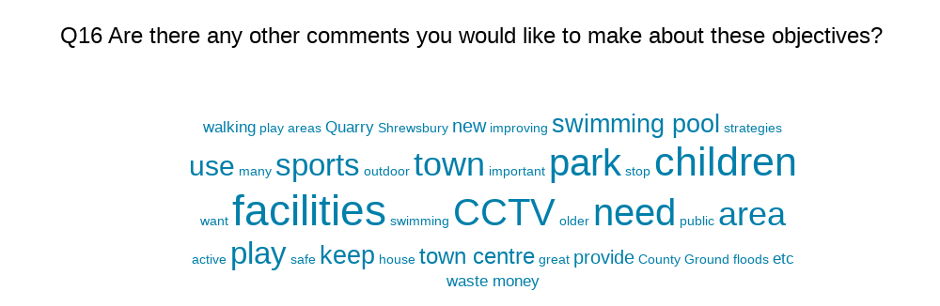

Slide 21

Strategic Ambition Three
Preserving Shrewsbury’s Heritage
We will continue to recognise the richness of Shrewsbury’s heritage and take steps to preserve its character, customs and traditions whilst recognising the need for the town to develop.
Our Key Objectives
To take an active role in the planning process for the Town
To create a long-term vision and management plan for the Quarry
To Support the work of the Big Town Plan and Movement & Public Space Strategy
To protect and enhance our heritage assets
To promote the town as a great place to live, work and visit

Slide 22
Q17: To support initiatives to maintain the conservation qualities of the town
Answered: 469 Skipped: 33

Slide 23
Q18: To contribute to the Castle and Rowley’s House Conservation Management Plan
Answered: 470 Skipped: 32

Slide 24
Q19: To take ownership of the old ‘Our Town’ signage based on the outskirts of the town.
Answered: 466 Skipped: 36

Slide 25
Q20: To develop a long-term management plan for the Quarry
Answered: 472 Skipped: 30

Slide 26
Q21: To contribute to strategic projects such as the Big Town Plan, and the Movement Strategy
Answered: 470 Skipped: 32

Slide 27
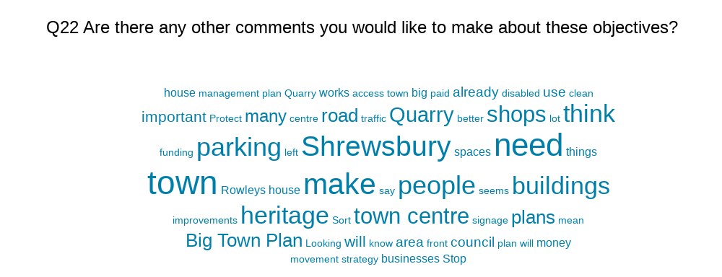

Slide 28

Strategic Ambition Four
Creating a greener and better-connected Shrewsbury
We will nurture and enhance our natural environment and public realm to ensure they are the accessible spaces local people want them to be allowing better connectivity and providing options for movement around the town.
Our Key Objectives
To work with partners to improve and manage the street scene across the town
To work with partners to improve river quality
To improve the provision of greenspace across the town
To enhance the Bloom portfolio
To ensure adequate provision of allotments and other community gardening space
To enhance and deliver a long-term Tree Management Plan

Slide 29
Q23: To take a more active role in the managements of the public realm including litter bin collections and street cleaning
Answered: 470 Skipped: 32

Slide 30
Q24: To develop opportunities for rewilding areas by reducing mowing frequencies and increasing sustainable planting
Answered: 469 Skipped: 33

Slide 31
Q25: To develop initiatives to support River Safety
Answered: 470 Skipped: 32

Slide 32
Q26: To campaign to reduce the use of combined sewerage outflows within the town
Answered: 473 Skipped: 29

Slide 33
Q27: To review, improve and promote Town Council footpaths
Answered: 471 Skipped: 31

Slide 34
Q28: To support Shrewsbury’s Britain in Bloom activities
Answered: 470 Skipped: 32

Slide 35
Q29: To develop Community Growing opportunities
Answered: 470 Skipped: 32

Slide 36
Q30: To install more planters/trees/shrubs out of town
Answered: 471 Skipped: 31

Slide 37
Q31: To identify land for tree planting/carbon sequestration
Answered: 470 Skipped: 32

Slide 38
Q32: To develop street trees/orchards
Answered: 468 Skipped: 34

Slide 39
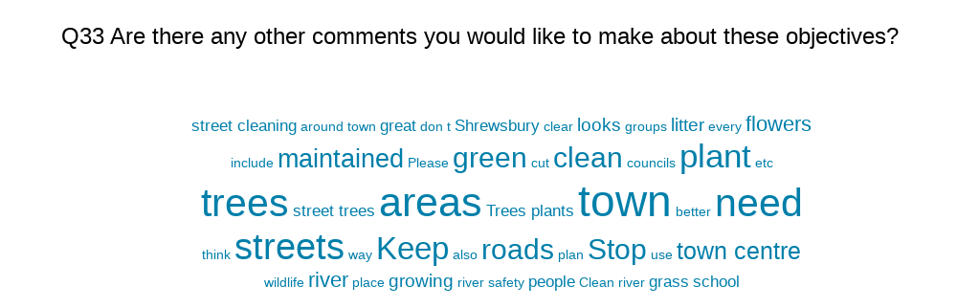

Slide 40

Strategic Ambition Five
Maintaining a sustainable, resilient and efficient organisation
We will ensure that we are suitably placed to deliver the priorities identified for Shrewsbury and its residents by employing people with the right skills, maintaining robust financial processes and optimising technology and resources.
Our Key Objectives
To develop an approach to advocacy on behalf of the Town Council and its residents
To continue to have a mutually beneficial relationship with Shropshire Council
To develop and deliver a Communications Strategy & Plan
To promote the involvement in the democratic process
To ensure effective financial governance is in place
To ensure Shrewsbury Town Council is a respected and supportive employer both locally and nationally
To ensure Shrewsbury Town Council has proactive and well-informed Councillors

Slide 41
Q34: To identify those themes and issues in which the Town Council will play a strong advocacy role
Answered: 460 Skipped: 42

Slide 42
Q35: To explore the delegation of services from Shropshire Council
Answered: 459 Skipped: 43

Slide 43
Q36: To develop Resident Drop-in Surgeries with Town Council Councillors to raise the issues important to you
Answered: 462 Skipped: 40

Slide 44
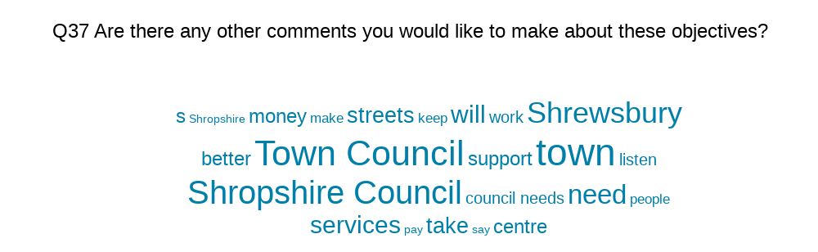

Slide 45

Strategic Ambition Six
Taking Positive action to tackle climate change
We will lead by example in reducing our carbon footprint, caring for our environment, using our resources responsibly to ensure we have a climate conscious town.
Our Key Objectives
To achieve Carbon Zero by 2030
To improve resilience in the town to cope with extreme weather
To work with the local community to raise awareness of Climate Change and Nature Recovery
To Promote Shrewsbury Town Council’s approach to transport including active travel

Slide 46
Q38: To ensure that Shrewsbury Town Council has a sustainable Nature Recovery and Climate Emergency plan for the future
Answered: 456 Skipped: 46

Slide 47
Q39: To promote the sponsorship of sedum bus stops
Answered: 447 Skipped: 55

Slide 48
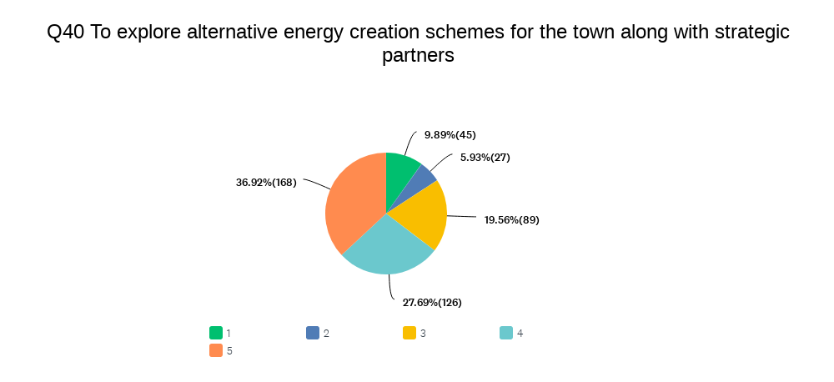

Slide 49
Q41: To invest in drinking water facilities in the Quarry in order to reduce plastic waste
Answered: 459 Skipped: 43

Slide 50
Q42: To support the local cycling and walking infrastructure
Answered: 458 Skipped: 44

Slide 51
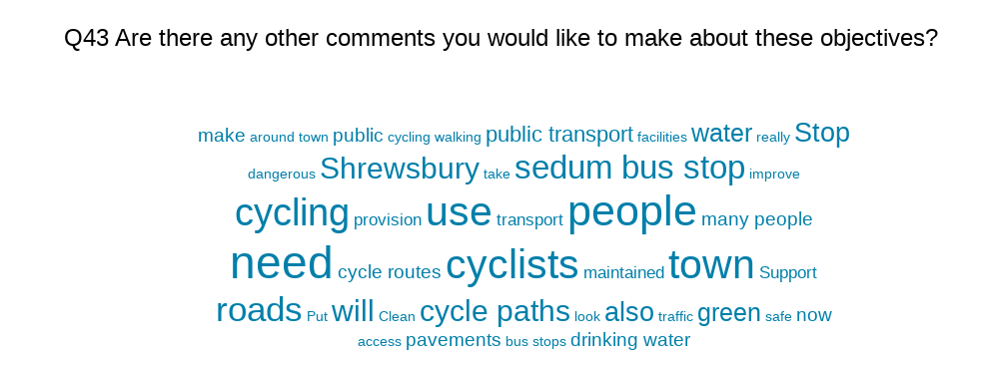

Slide 52
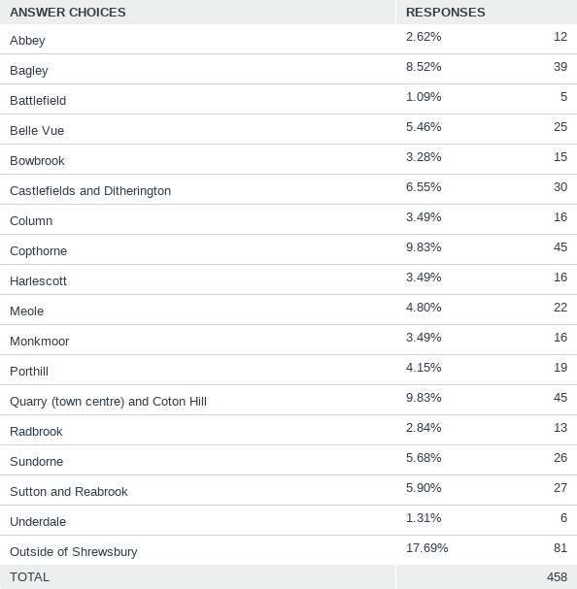
Q45: Which part of town do you live in?
Answered: 458 Skipped: 44

